Slide 1

Youtube Video Summarizer
Abraham Kong, Devi Priya Ravi, Dhanasree Rajamani, Sravani Thota

Slide 2
Introduction
Challenge: Time-consuming nature of consuming long-form YouTube videos.
Need: Efficient tool for quick understanding of video content.

Slide 3
Project Overview
Introduction to the "YouTube Video Summarizer."
Utilizes OpenAI's GPT model and prompt engineering.
Primary method: Summarization from video transcripts.
Secondary method: Speech-to-text conversion when transcripts are unavailable.
Application provides additional features such as language translation, summary of comments

Slide 4
Methods
Video ID extraction and metadata retrieval.
Direct transcript summarization using OpenAI's API.
Secondary approach: Audio downloading and speech-to-text conversion.
Integration of summarized content with video metadata.

Slide 5
Data
Data sources: YouTube video transcripts and metadata.
Diverse range of content across various genres.
Minimal preprocessing due to prompt engineering with GPT.

Slide 6
Translation for Global Accessibility
To make our tool universally accessible, we integrated a translation feature, utilizing the Google Cloud Translate API and googletrans library.
This feature allows the summarized content to be translated into multiple languages, catering to a diverse global audience.
The implementation involves automatically detecting the language of the summarized text and providing options to translate it into the user’s preferred language, thereby enhancing the tool’s usability and reach.

Slide 7
Experiments and Results
Testing across a wide range of YouTube videos.
Focus on accuracy and coherence of summaries.
Results showcased through screenshots in the paper.

Slide 8
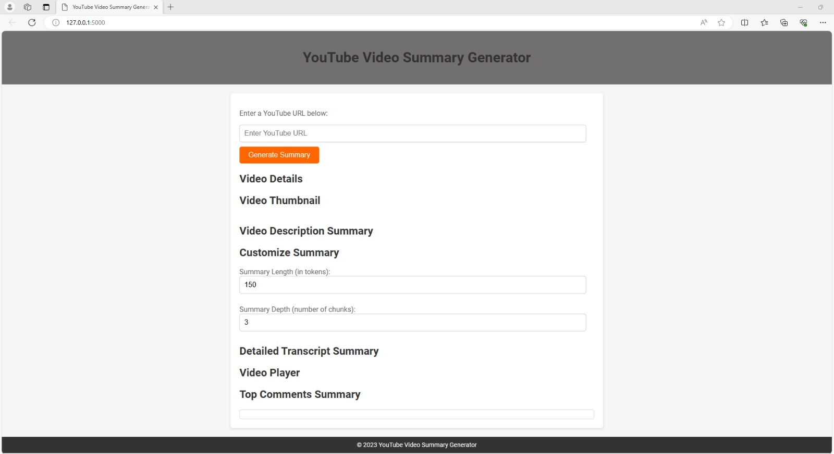
Experiments and Results

Slide 9
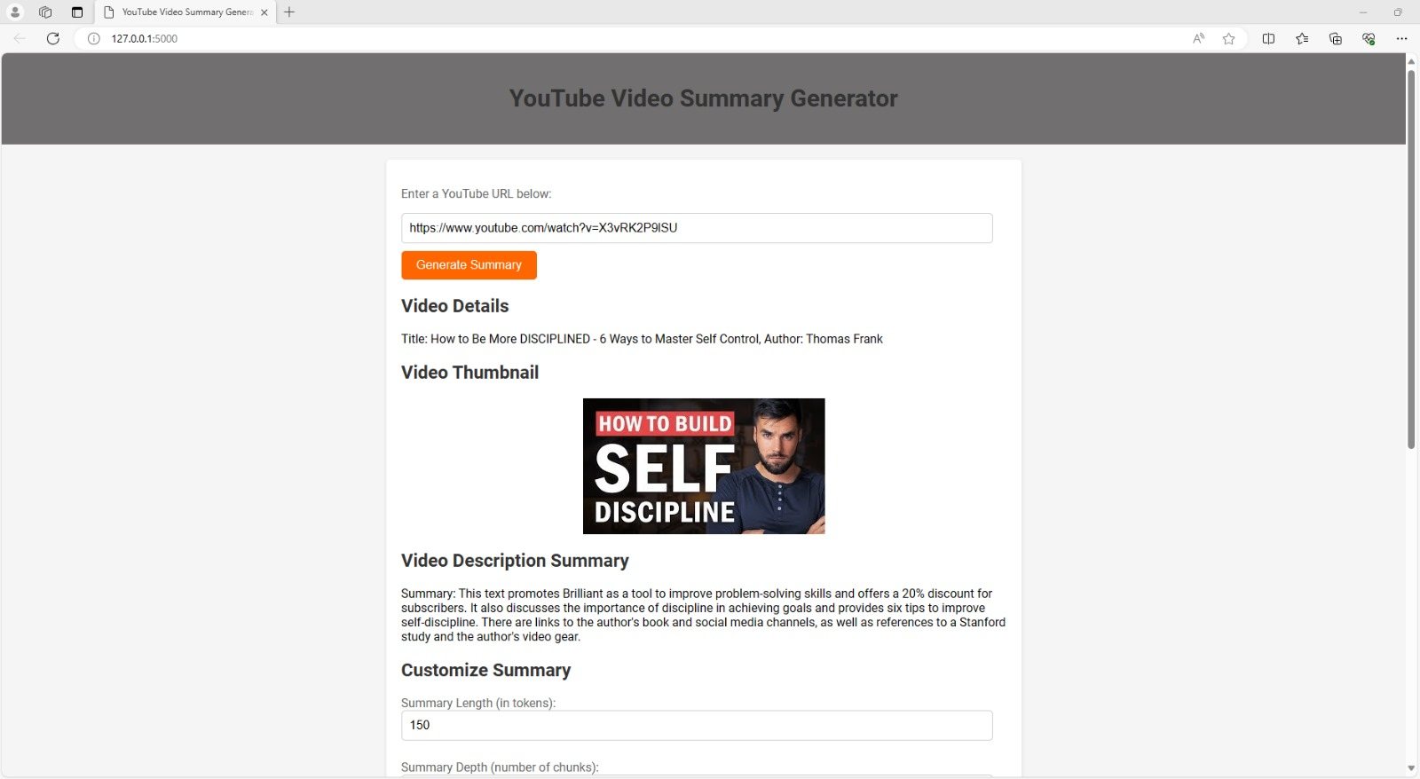
Experiments and Results

Slide 10
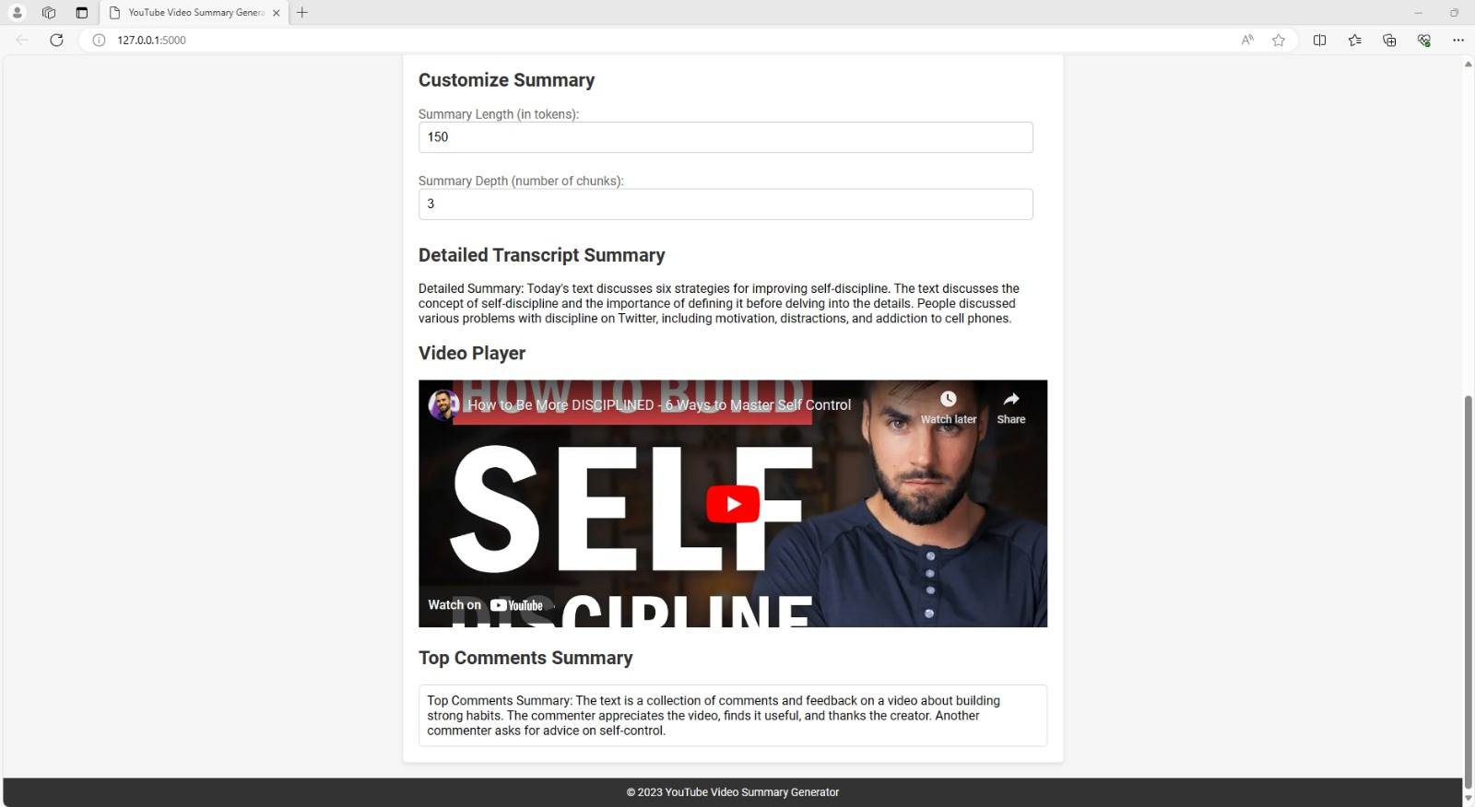
Experiments and Results

Slide 11
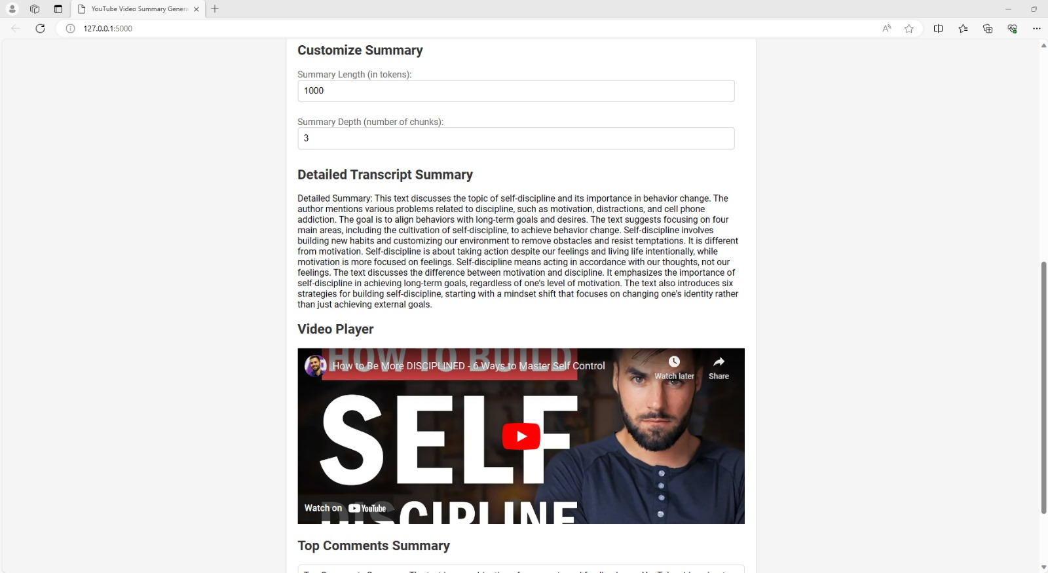
Experiments and Results

Slide 12
Conclusion and Future Directions
Successful development of an efficient video summarization tool.
Future potential: Language expansion, educational integration, real-time summarization, personalization, and accessibility features.
Transformative impact of AI in video content consumption.

